Slide 1
Draft/ Abandoned Notes
By Franco Fan 23 Jan 2024

Slide 2

Question 1

Slide 3
Borrower perspective, portal requirement:
Expectation and rationale: (Assume no priority in orders) 1st draft
List out top 10 wishes and rationale I would have if I am a lender for the portal
Handy - client are diversifying in demographic, but everyone wants convenience to save time and effort, especially the largest/continuous lender is more likely to be with higher age, it is wise to design an easy-to-use application to serve large demand from the main client segment.(24hr Anytime everywhere)
Efficient - no matter which kind of lender they are, great service from business world is always expected to be efficient, meaning the Service-Level Agreement must fulfill professional standard to keep the repetitive advantage of the business within the industry, accumulate the market share for continuous profitability (Simple process UI)
Predictable - lending is a traditional business which have a long history in the financial market, the compliance and procedure standard is continuously changing in different market, but the client expects the flow to be predictable that doesn’t change rapidly as service provider like banks are expected to be reputable, reliable for flexible business relationship with clients, given residential loans/ line of credit are long-term products, while fix & flip loans are short-term tools for clients (meets expectation, have stimulator)
Secured - security is a crucial factor in lending business as large damage in reputational and financial loss can be expected when the business risks are not handled properly(e.g. client credit data exposure, non-compliance with laws & regulations, fraud cases, operational risks etc) (privacy policy)
Stable - since long-term business-client relationship is expected in products, stable system performance is essential in keeping high client satisfaction. Clients will expect digital service is available in lending process nowadays, system downtime may cause series consequences in revenue, market share etc *High availability (traffic, network performance, disaster recovery, redundant server)
Informative - lenders is always expecting the lender can provide quick info for their personal loan status. (e.g. repayment record, active loan amount, repayment method, statement, interest rate, promotion, current plan, membership level details, full pay/re-loan option, cross-industry cooperation(fusion marketing etc) Client portal is expected to be able to provide real-time self-service in information service without manual convention.
Direct - client is expecting financial institute keeping the client info in a more direct relationship (not used by another company)Flexibility on client prefer communication. Email/phone/sms/mail
Progress update - as the portal is expected to be efficient, client will also demand the feature in application progress update, to provide info like estimated waiting time, approval result, documentation requirement, file upload functions and the channel to reach customer service / subject matter expert.
Electronic Reminder - client would expect notifications from company by channel like push notification, email, sms, mms etc to help them in managing their repayment, avoiding unwanted admin charged to their accounts.
Device friendly - borrower would want highest flexibility from doing business with the service provider, so they can enjoy high quality service in mobile, desktop, ipad or any other devices at any time.

Slide 4
Lender perspective, portal requirement:
Expectation and rationale: (Assume no priority in orders) 1st draft
List out top 10 wishes and rationale I would have as a product owner
As a business, the main concerns are a bit different:
Business sustainability - every business functions within portal should be compliance to avoid breaching any regulation that might cause series penalties like fines, license cancellation etc.
Standardize procedure - design of lending workflows in portal should be standardize to facilitate efficient client data management, reducing manual work to improve accuracy, shorten case processing time and ensure business operation standard.
Client value - it is important for company to identify the value of each client they have, the business records they have built, and what products might be suitable for them
Operation friendly - portal should ease the work for approval in tasks handling, improving business process efficiency. Helping approver in handling complex credit calculation such as loan-to-value ratio, liquidity asset for decision making. Making sure business compliance fulfilling regulatory and audit standards.
Information/sales trend analytics - portal is ideally capable in client data analytics, helping marketing department to better understand the key KPIs, client and sales trend, facilitate data-driven strategy for profitability improvement.
Client status monitoring - portal should alert the operator when there’s problem in client status like abnormal credit fluctuation, bankruptcy etc.
Customized operator authorization - credit decisioning may included different stage of operation which required the portal to set different authorization in functions for various level of worker to collaborate in the cases. Operators in company and client should be able to communicate in the portal.
Case by case features - application handling can be very different given clients have very diverse background; approver would need to customized some special handling or approval terms for some clients.
Risk evaluation - client application should be handled case by case based on the risk rationale behind, portal should be able to evaluate client and provide enough information for application processing
Security - portal should limit the access from operator to use personal device to access client information for lowering the risk of client info exposure.
Remarks: need to have Exceptional handling

Slide 5
Ideal business general workflow (draft)
Borrower:
create user profile->ID verification->submit application form->pending approval->getting approval result->accept/reject/adjust->end of application flow
Lender:
received application->data verification->credit rating assessment->decision making->sending approval result->getting client response->client accept and agreement processing->fund transfer->repayment collection->a/c monitoring(regulatory alert)->client data reporting->a/c closure->end of processing flow

Slide 6
Question 2

Slide 7
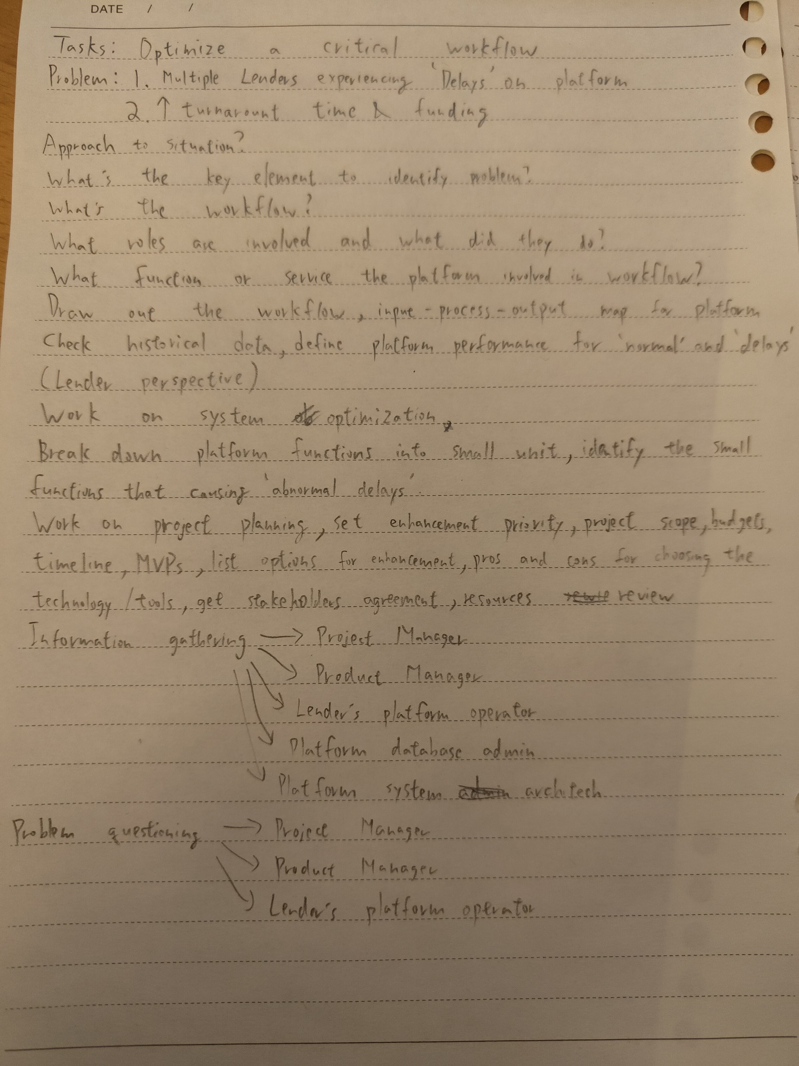
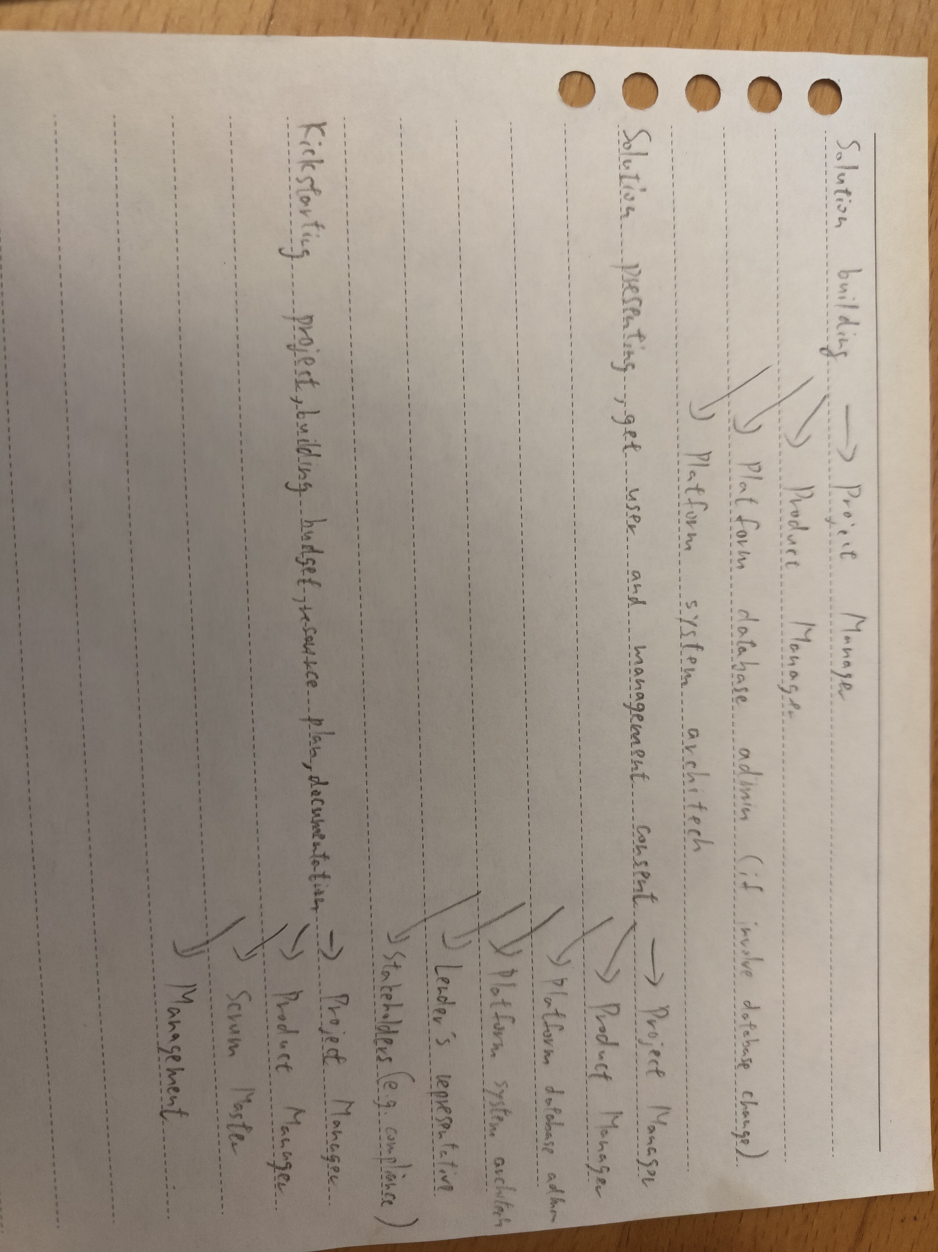
1st draft of abandoned notes for question 2

Slide 8
1st draft of abandoned notes for question 2
Define problem: system enhancement project
delay in system process (situational video/experience from user)
System workflow revisit to see if workflow is too complex
Root cause analysis (tech collaboration)
Communication and improvement plan on system enhancement
Problem research
Research for workflow, business, market
Identify delays in tiny process
Solution construction
Project presentation, MVP planning, budget plan, resources control, launching plan
Main focus: Turnaround, SLA, process time
Keep work and decision transparent
Have plans for: deployment, data comparison of leading time/monitoring, continuous follow-up to get user feedback for enhancement review, network traffic check
Possible solution for lowering SLA/process time: OCR

Slide 9
Q2 Workflow
You're a Business Analyst at Mortgage Automator and you've been assigned to a project to optimize a critical workflow. In your first few weeks, we discovered that multiple lenders on our platform have been experiencing delays, leading to increased turnaround times for approvals and funding.
Thinking Process
I will start by questioning:
What is the problem? Can I define them?
What is the workflow? What is the roles involved?
Where can I get information to help me analyzing the root cause? Who should I look for to get those info?
My approach involves 5 steps:
First, understanding how the business and platform operate.
Next, gathering all relevant platform details.
Then, breaking down issues into manageable parts and defining project goals.
Following this, I collaborate closely with stakeholders, create a clear delivery plan,
and seek budget approval.
Finally, kickstart the system enhancement project.

Slide 10
Q2 Task 1 & 2
Task 1 - How would you approach this situation?
My full answer to question 2 task 1:
To address any problem or enhancement opportunity, my initial steps involve a comprehensive questioning process. I start by identifying the problem and determining if it can be clearly defined. Understanding the workflow and roles involved is crucial, prompting inquiries into how the business and platform operate.
To analyze the root cause and gather relevant information, I seek information from key stakeholders and identify resources such as system documentation, previous project records, and interviews with users. This questioning phase helps me form a solid foundation for the subsequent steps.
My approach comprises five key steps.
Firstly, I focus on understanding the operations of both the business and platform. This is followed by gathering all relevant details about the platform. The third step involves breaking down identified issues into manageable parts and defining specific project goals. Subsequently, I collaborate closely with stakeholders to create a clear delivery plan, seek budget approval, and ultimately kickstart the system enhancement project.

Slide 11
Q2
Task 2 - Can you outline the steps you would take, any key factors
or actions you would take?
My full answer to question 2 task 2:
I begin the enhancement process by gathering comprehensive information about the platform, including performance metrics, user expectations, business workflows, and the roles involved. These information can be discovered from stakeholders, system documentation, previous projects, database records, interviews with users, and internet research.
The next step involves identifying performance issues by questioning delays and understanding the differences between 'delays' and 'normal' in platform operations. Collaborating with project managers, product managers, and users, we define the duration differences and break down problems into minimal unit processes. Through this analysis, we estimate durations, compare them with historical data, and determine whether the issues stem from manual or system processes. Solutions are then crafted, such as organizing platform training sessions for manual processes or collaborating with technical leads to identify tools or technologies for system enhancement. Costs, manpower, and time are evaluated with project and product managers, considering various options and their pros and cons.
Once the solutions are agreed upon, the project is initiated. (One possible solution is implementing Optical Character Recognition(OCR) technology into the business process. This finding is inspired by market research.) I present the possible options to stakeholders, ensuring mutual consent on the project's direction, budget, and timeline. The project is kicked off with detailed documentation, collaboration with the technical team to ensure quality deliverables, and planning with the project manager for resources, testing, and launch. Throughout the project, I prioritize minimizing business effects on users during system deployment and maintain continuous communication between users and technical teams regarding product enhancements.
In summary, my approach involves six key steps:
Understanding the platform and workflow,
Identifying problems,
Building solutions,
Initiating the project,
Contributing to its progress,
Closing the project.
To ensure efficiency and transparency, I will keep detail records, track development progress closely, and ensure communicate within project teams and the transparency for any changes in the project.

Slide 12
Q2 2. Can you outline the steps you would take, any key factors or actions you would take?
My Steps will be as following:
Gathering information for the platform, performance(both current and historical), user expectation, business workflow, every involved roles within process, stakeholders involved, and any research needed in enhancing the platform. Those information can be gathered from stakeholders, system documentation, previous project documentation, database record, interviews with users, internet research etc.
Problem questioning to know the difference between ‘delays’ and ‘normal’ in platform performance, discussing with project manager, product manager, user to define the duration differences. Breakdown problem into minimal unit process to check where did the ‘delayed’ happened, figure out estimated duration for each unit process and compare the fact with historical data. Identify if it is manual process or system process, evaluate the resources we need to enhance the efficiency. E.g. if it is a manual process, platform training session may help operator in getting familiar with the operation, improving efficiency and so shorten the process time. If it is system process, work with technical lead in finding any tools/ technology can be used to enhance user experience. Evaluate the costs, manpower, time with project manager and product manager, figuring out options with pros and cons.
Project building, showing the possible options to address the problems, presenting solutions to get stakeholders mutual consent in the project direction, budget and timeline. Kickstarting the project with detailed project documentation, working with technical team in ensuring quality deliverables in timely manner. Work with project manager in resources planning, testing arrangement and launching plans. Minimalize the business effects to users during system deployment, supporting continuous communication on product enhancement between users and tech teams.
In short, the steps I take can be simplified to 6 steps:
Platform/ workflow understanding->problem identification->solution building->project initiation->project contribution->project closing
Key factors/ actions I would take:
Keep every information/ discussion in record, maintain a detailed knowledge database to avoid information loss.
Making sure development progress on track, timely follow-up when requirement/ task priority change.
Ensuring any changes to the project are transparent to stakeholders.

Slide 13
Q2
Turnaround, SLA, process time,
Follow project management approach and give solid actions
transparent, deployment, data comparison of leading time/monitoring, feedback for enhancement review, network traffic check,
Possible Solution: OCR
Possible data error:
Q3 time format, !+_ @, data structure/format, date format, value restriction, null

Slide 14
Question 3

Slide 15
Q3 Data Analysis
Task 2 - Help structure an email back to the client, asking them to please correct their mistakes, so we don’t have to take on the workload of cleaning up their data.
Elements needed from the email:
Professional
Helpful
Informative
Specific
Polite
Reasonable
Formal
Message to be delivered:
Welcoming new client for onboarding,
Expressing our happiness to work with them,
Explaining the current situation,
Carefully mention the mistakes they have been made with examples,
Politely ask them to correct their mistakes,
Thanking the client from using our services

